Slide 1
Computer Networks
“Introduction - 1”
Asst. Lect. Ahmed M. Jasim
Computer Department - College of Engineering
University of Diyala
2017

Slide 2
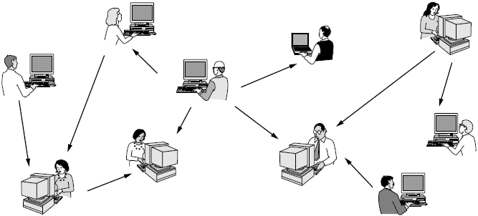
Network Definition
A Computer Network is a collection of devices connected together to provide certain services to the users.

Slide 3
What is the difference between a distributed system and a computer network?
Distributed systems are computing nodes that communicate with each other on purpose of processing data or running applications.
Computer networks are nodes that communicate of purpose of exchanging data and deliver it from node to other or multiple nodes.

Slide 4
USES OF COMPUTER NETWORKS
Share Resources
Exchange of information by means of e-Mails and FTP.
Information sharing by using Web or Internet.
Interaction with other users using dynamic web pages.
IP phones.
Voice over IP (VoIP).
Video conferences.
Parallel computing.
Instant messaging.
VPNs (Virtual Private Networks).
E-commerce (Electronic Commerce).
Social network applications.

Slide 5
NETWORK COMPONENTS
Network has three main components:
1- End Devices (hosts, servers).
2- Network devices
(repeater, hub, bridge, switch, router, NIC, modem)
3- Connectivity (cables, wireless)

Slide 6
NETWORK HARDWARE
1- Transmission technology:
A- Point-to-point
Point-to-point links connect individual pairs of machines.
packets may have to first visit one or more intermediate machines.
Point-to-point transmission with exactly one sender and exactly one receiver is sometimes called unicasting.
B- Broadcast
the communication channel is shared by all the machines on the network
packets sent by any machine are received by all the others.
Broadcasting
Multicasting

Slide 7
NETWORK HARDWARE
2- Scale
Distance | Area | Type of Network
1 m | Square meter | Personal Area Network
10 m | Room | Local Area Network
100 m | Building
1 km | Campus
10 km | City | Metropolitan Area Network
100 km | Country | Wide Area Networks
1000 km | continent
10000 km | Plant | Internet

Slide 8
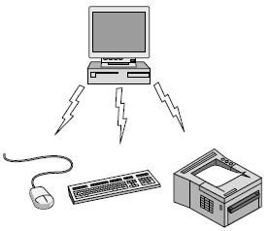
NETWORK HARDWARE
A- Personal Area Network (PAN)
A Personal Area Network (PAN) is smallest network which is very personal to a user.
For example, Piconet is Bluetooth-enabled Personal Area Network which may contain up to 8 devices connected together in a master-slave fashion.

Slide 9
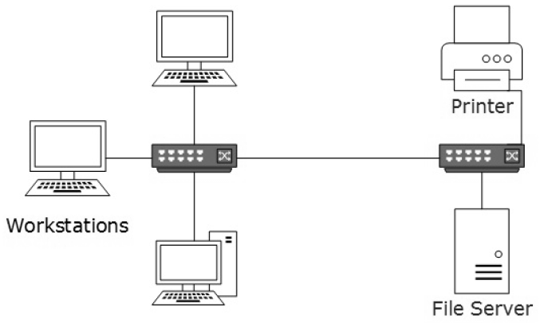
NETWORK HARDWARE
B- Local Area Network (LAN)
LAN covers an organization office, schools, colleges or universities.
Operates under single administrative system
LAN provides a useful way of sharing the resources
Inexpensive networking.
Contain local servers
Operates on private IP addresses
LAN works under its own local domain and controlled centrally.
LAN uses either Ethernet or Token-ring technology.
LAN can be wired, wireless, or in both forms at once.

Slide 10
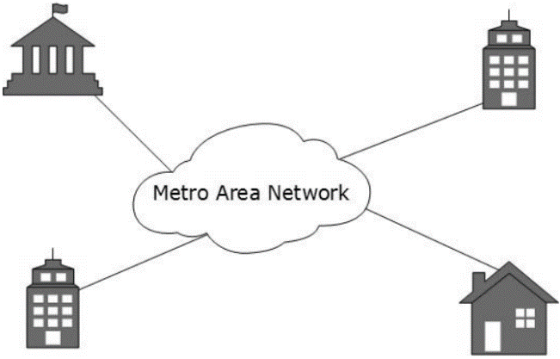
NETWORK HARDWARE
C- Metropolitan Area Network (MAN)
Expands throughout a city such as cable TV network.
MAN uses Ethernet, Token-ring, ATM, or Fiber Distributed Data Interface (FDDI).
Backbone of MAN is high-capacity and high-speed fiber optics.
MAN works in between LAN and WAN.
For example, MAN can help an organization to connect all of its offices in a city

Slide 11
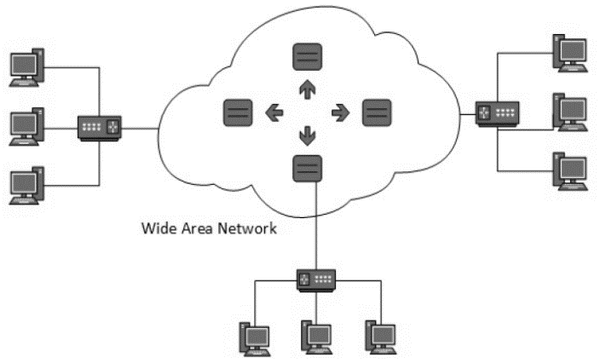
NETWORK HARDWARE
D- Wide Area Network (WAN)
Covers a wide area
These networks provide connectivity to MANs and LANs.
Backbone of WAN is high-capacity
WANs use very expensive network equipment.
WAN may use advanced technologies such as Asynchronous Transfer Mode (ATM), Frame Relay, VPN, MPLS, and Synchronous Optical Network (SONET).
WAN may be managed by multiple administration.

Slide 12
NETWORK HARDWARE
E- Internetwork
It is the largest network
Internet uses TCP/IP protocol suite
Present day, Internet is widely implemented using IPv4.
Internet enables its users to share and access enormous amount of information worldwide.
It uses World Wide Web (WWW), File Transfer Protocol (FTP), email services, audio, and video streaming etc.
At huge level, internet works on Client-Server model.
Internet uses very high speed backbone of fiber optics
Internet is widely deployed on World Wide Web services using Hyper Text Markup Language (HTML)
Web sites, E-mail, Instant Messaging, Blogging, Social Media, Marketing, Networking, Resource Sharing, and Audio and Video Streaming.

Slide 13
NETWORK HARDWARE
Computer networks can be discriminated into various types such as
Client-Server
Peer-to-Peer
Hybrid

Slide 14
NETWORK SOFTWARE
1- Protocol Hierarchies
To reduce their design complexity, most networks are organized as a stack of layers or levels, each one built upon the one below it.
The purpose of each layer is to offer certain services to the higher layers
This concept is used throughout computer science (information hiding, data encapsulation, and object-oriented programming).

Slide 15
NETWORK SOFTWARE

Slide 16
NETWORK SOFTWARE
Protocol is an agreement between the communicating parties on how communication is to proceed.
The entities comprising the corresponding layers on different machines are called peers
Between each pair of adjacent layers is an interface. The interface defines which primitive operations and services the lower layer makes available to the upper one.
A set of layers and protocols is called a network architecture.
A list of the protocols used by a certain system, one protocol per layer, is called a protocol stack.

Slide 17
NETWORK SOFTWARE

Slide 18
NETWORK SOFTWARE
2- Design Issues for the Layers
A- Reliability
Making a network that operates correctly through Find and fix the errors by:
Error detection
Error correction
Another reliability issue is finding a working path
B- The evolution of the network
Designs that continue to work well when the network gets large are said to be scalable.

Slide 19
NETWORK SOFTWARE
C- Resource allocation
Statistical multiplexing: sharing based on the statistics of demand.
How to keep a fast sender from swamping a slow receiver with data. This subject is called flow control.
The network is oversubscribed because too many computers want to send too much traffic, and the network cannot deliver it all. This overloading of the network is called congestion.
Quality of service.

Slide 20
NETWORK SOFTWARE
D- Security
Secure the network by defending it against different kinds of threats.
Eavesdropping on communications.
Mechanisms that provide confidentiality defend against this threat, They are used in multiple layers.
Mechanisms for authentication prevent someone from impersonating someone else.

